Slide 1
Buy Shipment View

Slide 2
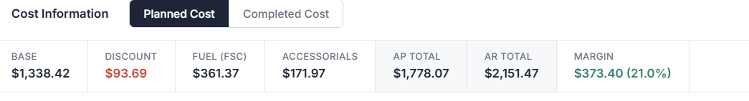
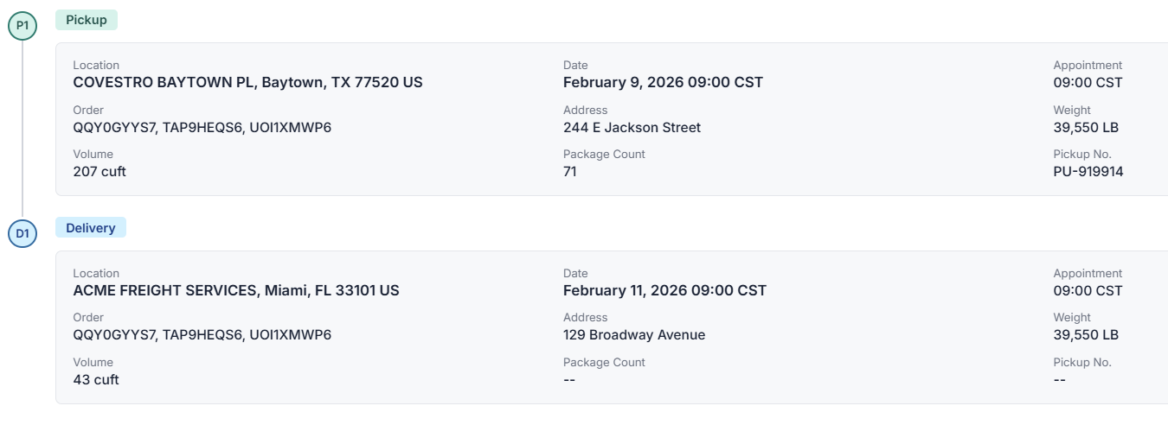

Buy Shipment
8956
Pro/Booking #
67819A88
Tracking Link
Rating Status
Successful
Sell Shipment
9678
General Information
Source Name | USALCO | "org_long_name" looked up using SOURCE_ID passed on order
Shipment Status | Accepted
Carrier | CTNS
Pickup Date/Time | from current option
Delivery Date/Time | from current option
Gross Weight | 44470 LB
Volume | 200 cuft
Mode | LTL
Equipment | LTL
Freight Term | Collect
Hazmat | Yes | Yes / No
Base | $2,900.00
Fuel (FSC) | $250.00
Accessorials | $56.00
AP Total (Carrier) | $3,206.00
AR Total (Customer) | $3,456.00
Margin | $ 250 - 7.7%
Direct Cost | $3,906.00
Cost
Stops
- Hyper link on the order
Address should be included
Check story – LINX -
User Defined Fields
Customer Reference Values

Slide 3
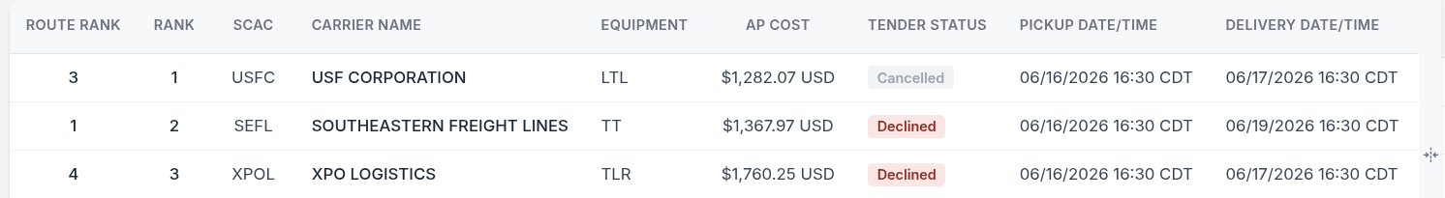
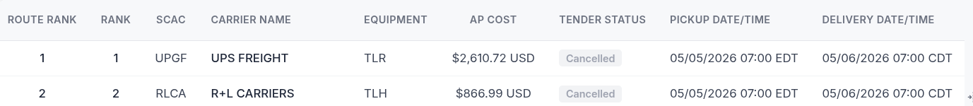
Review Order Change - Direct – Page 1/3
Button
Display
Cancel Tender
Buy Shipment
8956
Keep Tender
Quoted Cost
Prior
New
Re-Tender
Prior Cost
1000 USD
SCAC
Equipment
Route Rank
Rank
Tender Status
SCAC
Equipment
Route Rank
Rank
Tender Status
New Cost
900 USD
CTNS
LTL
4
2
Sent
CTNS
LTL
5
1
Bypass Tender
New Quote
900 USD
Pickup Date
06/03/2026 16:30 CDT
Delivery Date
06/04/2026 16:30 CDT
Pickup Date
06/05/2026 16:30 CDT
Delivery Date
06/06/2026 16:30 CDT
New Tender List
View Tender
Prior Tender List

Slide 4
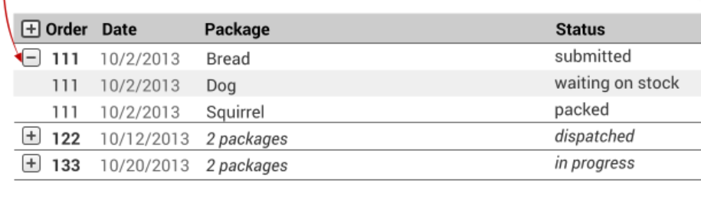
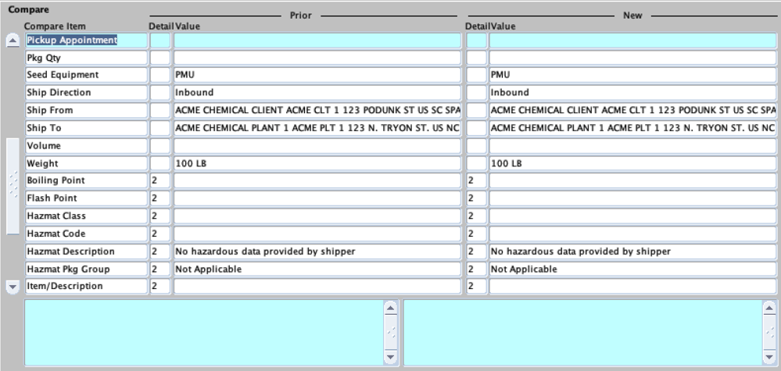
Review Order Change – Direct – Page 2/3
Button
Display
Cancel Tender
Buy Shipment
8956
Keep Tender
Quoted Cost
Prior
New
Re-Tender
Prior Cost
1000 USD
SCAC
Equipment
Route Rank
Rank
Tender Status
SCAC
Equipment
Route Rank
Rank
Tender Status
New Cost
900 USD
CTNS
LTL
4
2
Sent
CTNS
LTL
5
1
Bypass Tender
New Quote
900 USD
Pickup Date
06/03/2026 16:30 CDT
Delivery Date
06/04/2026 16:30 CDT
Pickup Date
06/05/2026 16:30 CDT
Delivery Date
06/06/2026 16:30 CDT
New Tender List
Prior Tender List
Compare Screen

Slide 5
Review Order Change – Direct – Page 3/3
Button
Display
Compare screen fields
Fields | Example | Source
Delivery Date | 06/04/2026 08:00 CST, MON | Routing
Pickup Date/Time | 06/02/2026 08:00 CST, WED | Routing
Distance | 282 MI | Routing
Distance source | PCMILER PRACTICAL BORDERS OPENED V24
Incoterm Info | FOB | Order
Network Leverage | Y/N | Routing
Order Requested Date | SSD/RDD, Date Time | Order
Bill To |  | Order
Delivery Appointment | 6/4/26 3:00 PM | Order or entered in Shipment
Freight Terms |  | Order
Pickup Appointment | 6/2/26 3:00 PM | Order or entered in Shipment
Package Count
Seed Equipment | PMU | As entered on the Order
Ship Direction | Inbound | Order
Ship From | Add 1,2,3, city, State, Zip, Country | Order
Ship To | Add 1,2,3, city, State, Zip, Country | Order
Volume | 100 Cuft | Shipment
Gross weight | 2000 LB | Total of the Shipment
Boiling Point | Line # 100 C Line # 101 C | Order. If multiple line exist in an order, list Boiling Point by Line or Sequence #
Flash Point | Same as Boiling Point | Same as Boiling Point
Hazmat Class | I | Order. If multiple line exist in an order, list Boiling Point by Line or Sequence #
Hazmat Code | UN0012 | same as Hazmat class
Hazmat Description | Flammable Liquid | Source from order. If muntiple line exist, should show by Line/sequence #
Hazmat Pkg Group | II | same as Hazmat class
Item/Description | Asadero | Description of item. Multiple items, show by line/seq #
Marine Pollutant | Check box | Order. Checkbox by line/seq
Shipping Class | 75 | From Order
Tunnel Code | 1 | From Order
WGK Class | II | From Order

Slide 6
Consolidation - Multi Stop Order Change

Slide 7
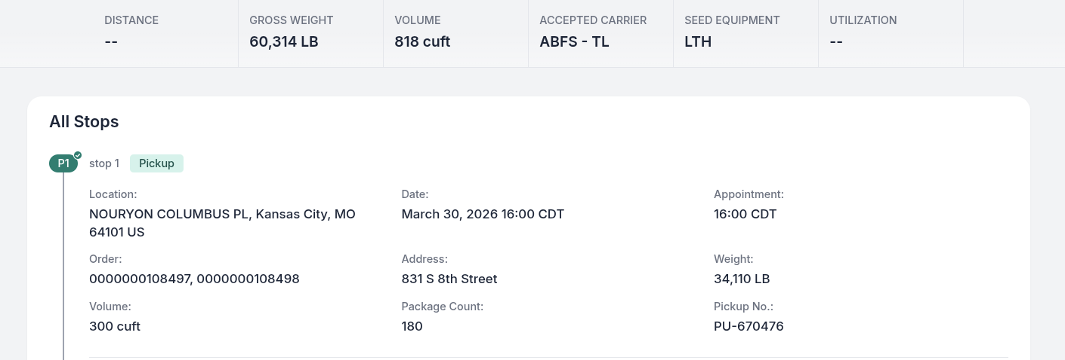
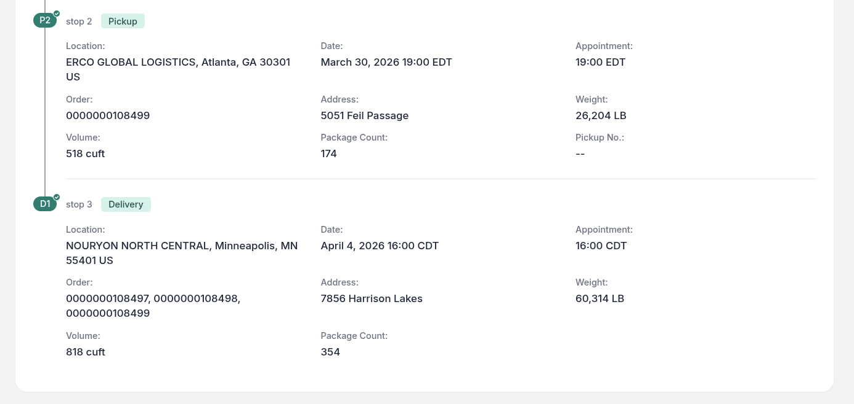
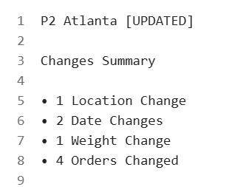
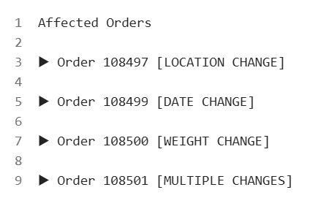
Planning Date Type
Anchor Date
Approve Plan
Edit Shipment Stope
RDD
3/20/2026
User clicks on the order and see side by side compare of the change

Slide 8
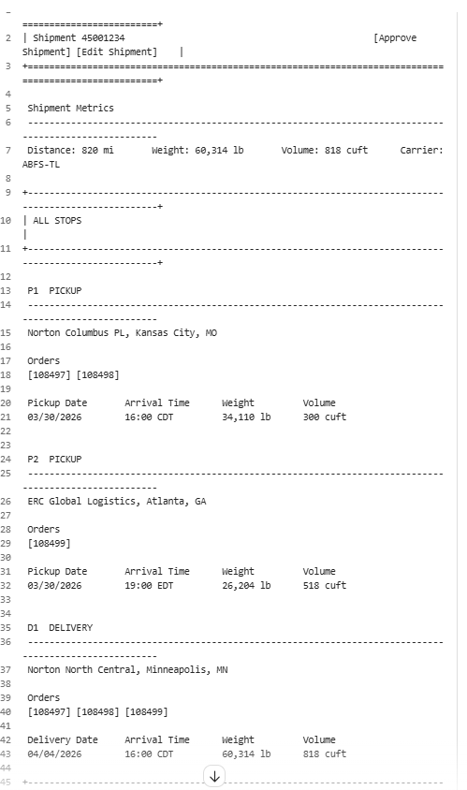
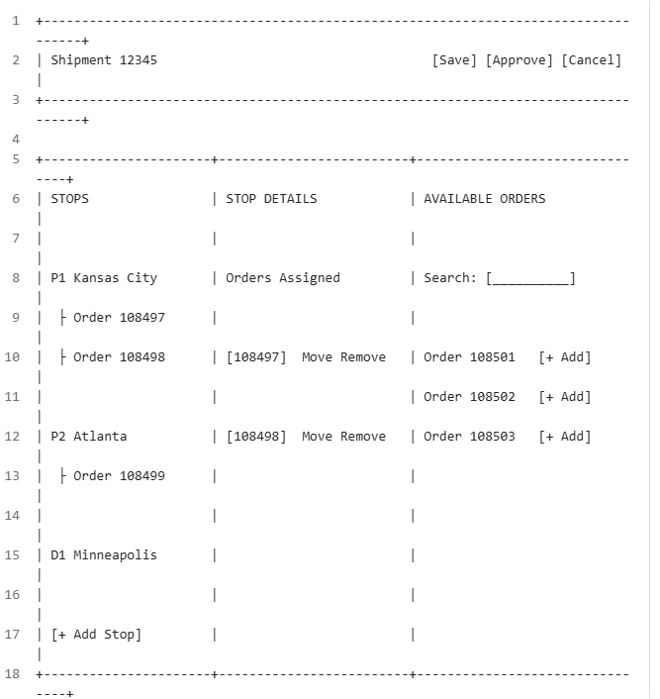
Before EDIT
Approve Plan
Edit Shipment Stope
Planning Date Type
Anchor Date
RDD
3/20/2026
Planning Date Type
Anchor Date
RDD
3/20/2026
3 SECTIONS
Stops
Order actions
Add Orders
EDIT

Slide 9
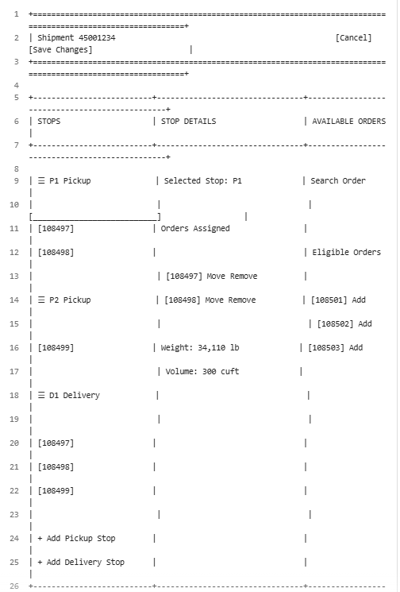
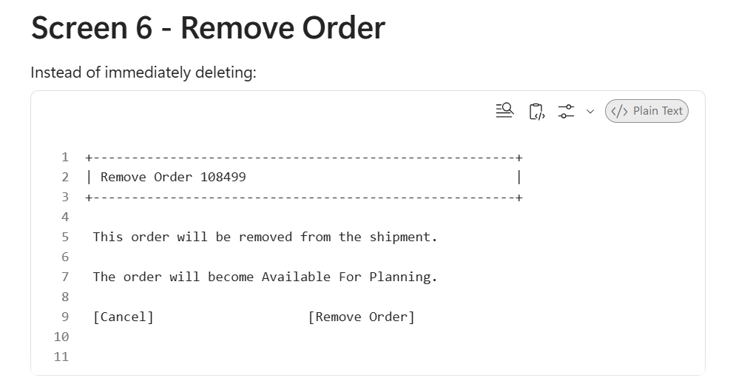
EDIT Stop
System auto selects Stop P1 for user to Edit. User can Select P2 or D1 or any stop and corresponding order details to be populated
Order Tool Tip display:
Planning Type: SSD/RDD
Pickup/Delivery Date Time: 6/3/2026 08:00
Gross weight: 1000 LB
Volume: 30 Cuft
Origin: City, State, Postal, Country
Destination: City, State, Postal, Country
User should be able to drag and drop the stops
1. Logic should be available to prevent user saving changes like, order being delivered, before being picked up,
Order # will be displayed as chip
Move: User will have option to drag and move the order to any stop (P2,P3,D1)
Remove: Remove button.
Remove will remove order from Shipment (pickup and delivery). Moves it to the available order list (in case the user wants to add order again). Finalized the removal once user confirms the change.
Note: Should have logic that prevents order just being in delivery without a pickup or vice versa. Similarly, pickup of the order should happen before delivery
User should be able to add stops (Pickup or Delivery)
User should not be able to finalize the shipment without adding at least one order to the stop.
Similarly, the same order should be picked up before being delivered.

Slide 10
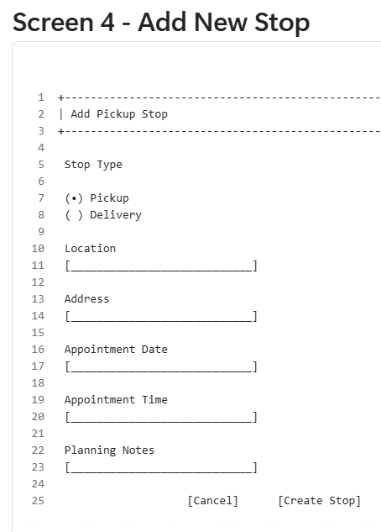
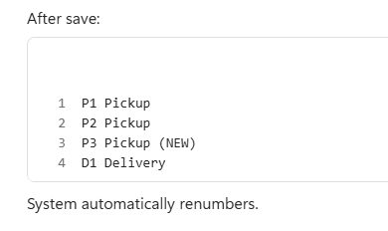
New stop is added to the bottom of that stop type (Pickup or delivery)

Slide 11
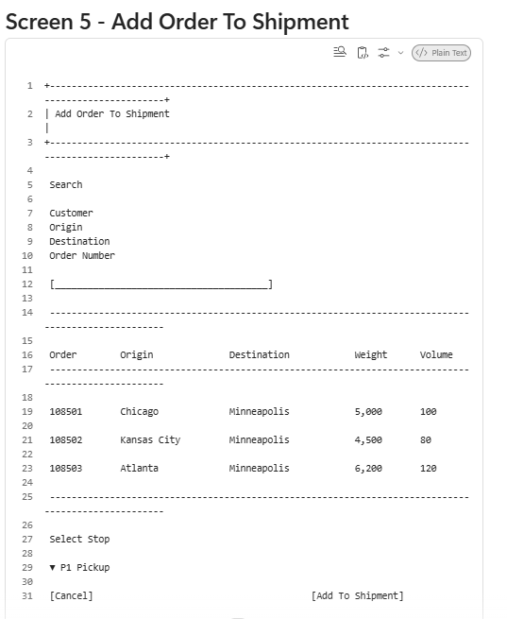
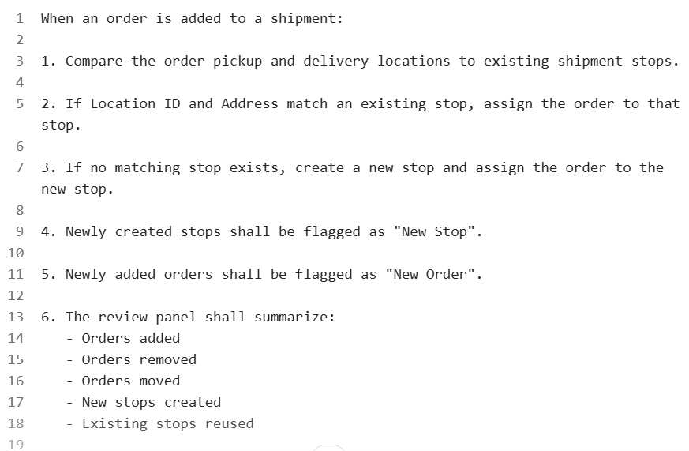
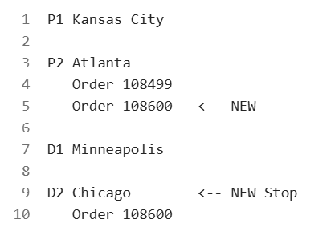
Rules to add another shipment
Search by
Customer, Origin, Destination, Order #, Buy shipment, Shipment Status, Tender Status
Details as in the Shipment Grid
User should not be able to add shipments / Orders already Tender ‘Sent’ or ‘Accepted’
Should reflect the change under the stops

Slide 12
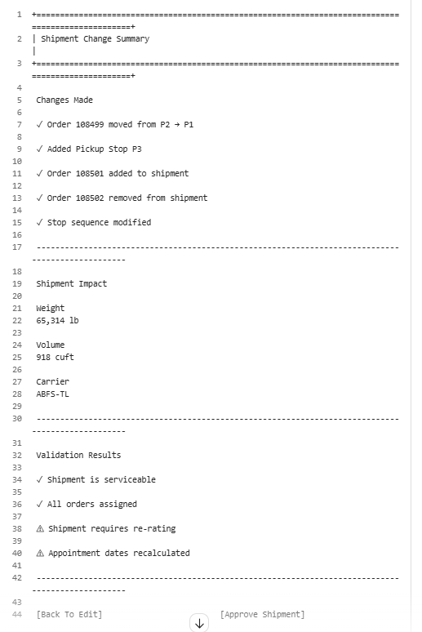
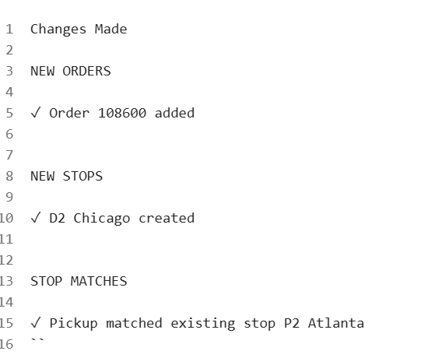
Review Change
When new order is added-Review change details as below

Slide 13
